Slide 1

LOAN PREDICTION USING MACHINE LEARNING
Aman Sharma
M.Sc. in Big Data Analytics, Department of Computer Science
Ramakrishna Mission Vivekananda Educational And Research Institute
Belur Math, Howrah

Slide 2
POINTS UNDER DISCUSSION
INTRODUCTION
PROJECT IDEA
PROJECT DATASET
PROJECT WORK
PROJECT RESULTS
CONCLUSION

Slide 3
1. INTRODUCTION :
Machine Learning is the systematic study of algorithms and systems that improve their knowledge or performance with experience. Machine Learning focuses on the development of computer programs that can access data and use it to learn for themselves.
Loan Prediction is a very important part in our today's life. More often than not, it seems to have been seen that people from different background , different social status, different education level apply to get a loan. But not everyone who applies is approved of loan.
We have applied PCA on Dataset and get the idea of features require to describe properly. In this Project, it is worked on how different background , social status and education level can effect your loan application and depending on the result we can conclude. Here we have applied Logistic Regression Model, KNeighbors Classier Model, SVC and Decision Tree Classier Model on our Loan Dataset and check which model can predict better.

Slide 4
2. PROJECT IDEA :
The idea behind this Project is to build models that will classify the loan prediction properly . It is based on the applicant's martial status, education, number of dependents, and employments. We can visualize the dataset and can get some information.
We have also applied PCA to get the idea of how much components are required to explain the data properly. At last, we done models and calculate Accuracy to get the idea of fitted models.
3. DATASET :
The Dataset that I have used here for my Project is called “loan.csv”. The dataset has a shape of (614,13). Here there are different columns indicating different features contributing in the Project. The column names are Loan ID, Gender, Married, Dependents, Education, Self Employed , ApplicantIncome , CoapplicantIncome , LoanAmount , Loan Amount Term, Credit History , Property Area, Loan Status that will appear respectively in the dataset.

Slide 5
4. PROJECT WORK :
In this Project, different kind of Visualizations are done as we have different categories . Depending on the relationships between features we can also conclude various important aspects of the Train Dataset.
Dataset Description :
Here a summary has been presented in a tabular form to describe the dataset . The Dataset has both Categorical and Numerical Data. We can only summarize the Numerical Data.
Count = No of observations in each category.
Mean = Average no of observations in each category. On an Average what is the no denoting the numerical features.
SD = The Deviation from mean of each observation under each category. It denotes how much deviated the dataset features are.
Min = Minimum of each Numerical features in the dataset.
0.25 = It is the 25th percentile of the data. How much observations lie in the 25th percentile of the dataset.
0.5 = It is the 50th percentile of the data. How many observations lie in the 50th percentile of the dataset.
It is also called MEDIAN.
0.75 = It is the 75th percentile of the data. How many observations lie in the 75th percentile of the dataset.
Max = Maximum of each Numerical features in the dataset.

Slide 6
DATASET DESCRIPTION FOR NUMERICAL FEATURES
CATAGORY | Applicant Income | Coapplicant Income | Loan Amount | Loan Amount Term | Credit History
count | 614.000000 | 614.000000 | 592.000000 | 600.00000 | 564.000000
mean | 5403.459283 | 1621.245798 | 146.412162 | 342.00000 | 0.842199
std | 6109.041673 | 2926.248369 | 85.587325 | 65.12041 | 0.364878
min | 150.000000 | 0.000000 | 9.000000 | 12.00000 | 0.000000
25% | 2877.500000 | 0.000000 | 100.000000 | 360.00000 | 1.000000
50% | 3812.500000 | 1188.500000 | 128.000000 | 360.00000 | 1.000000
75% | 5795.000000 | 2297.250000 | 168.000000 | 360.00000 | 1.000000
max | 81000.000000 | 41667.000000 | 700.000000 | 480.00000 | 1.000000

Slide 7
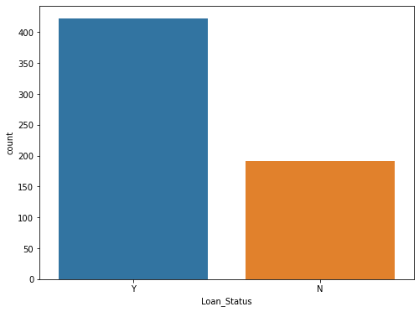
Visualization Of Different Categories :
Bar Plots For Different Features :
Percentage Count of Loan Status
The percentage of Y class : 0.69
The percentage of N class : 0.31

Slide 8
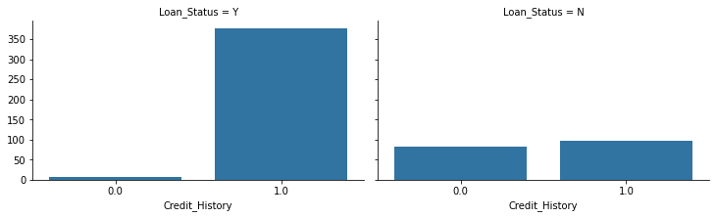
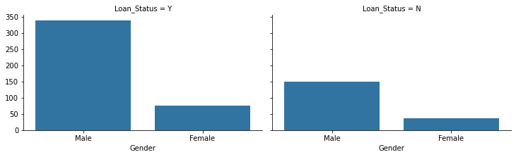
So, we can say that for Loan Status = Y,
we didn't give a loan for most people who got Credit History = 0
but we did give a loan for most of people who got Credit History = 1
So if you got Credit History = 1 , you will have better chance to get a loan.
For Loan Status = N, we can say that
it is almost equal for the cases, whatever your credit history maybe.
So it is not a good way to measure the association between Credit History and Loan Status.
Loan Status Association With Credit History
Here it is seen that, in Loan Status= Y
Most of the Males get loan as well as Females,
though the no is less.
So regarding getting the loan Status, Gender is
not a deciding factor.
For Loan Status = N, it is clear that
it is almost same for the cases, whatever your
Gender maybe.
So it is not a good way to measure the association
between Gender and Loan Status.
Loan Status Association With Gender

Slide 9
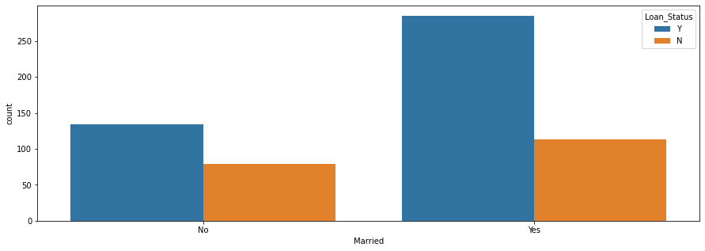
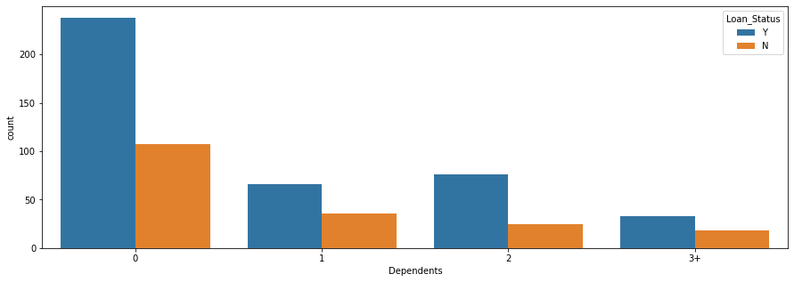
Here it is seen that , in Loan Status= Y
Most of the person who are Married get loan as well as Unmarried Person, though the no is less.
So regarding getting the loan Status, married person has better chance in getting loan.
For Loan Status = N, it is clear that
it is almost same for the cases, whatever your martial status maybe.
So it is not a good way to measure the association between Loan Status and Martial Status.
Loan Status Association With Marriage
Here it is seen that , in Loan Status= Y
Those who have 0 Dependents have most chance of getting loan.
It decreases gradually regarding the dependent.
So, accordingly Dependents with 1,2 and 3+ also have chance of getting loan but of less no.
For Loan Status = N, it is clear that
it is almost same for the cases, whatever Dependents maybe.
For Dependents 0 it is also most and decreasing gradually.
Figure
Loan Status Association With Dependents

Slide 10
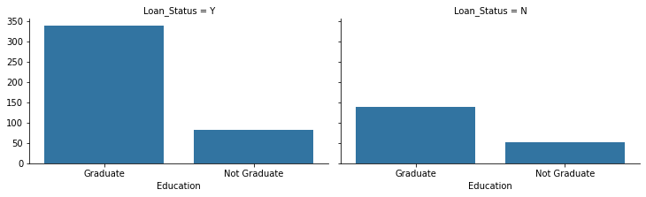
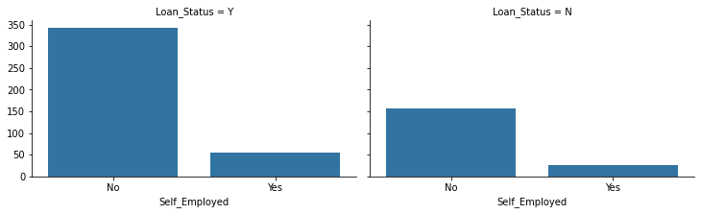
Here it is seen that , in Loan Status= Y
Most of the person who are Graduated get loan as well as Ungraduated, though the no is less.
So regarding getting the loan Status, Education is not a
deciding factor.
For Loan Status = N, it is clear that
it is almost same for the cases, whatever your Education status maybe.
So it is not a good way to measure the association between Loan Status and Education Status.
Loan Status Association With Education
Here it is seen that , in Loan Status= Y
Most of the person who are Not Self-Employed get loan
as well as Self-Employed, though the no is less.
So regarding the loan Status, Self- Employment is not a deciding factor.
For Loan Status = N, it is clear that
it is almost same for the cases, whatever your
Self-Employment status maybe.
So it is not a good way to measure the association
between Loan Status and Self-Employment Status.
Loan Status Association With Self-Employment

Slide 11
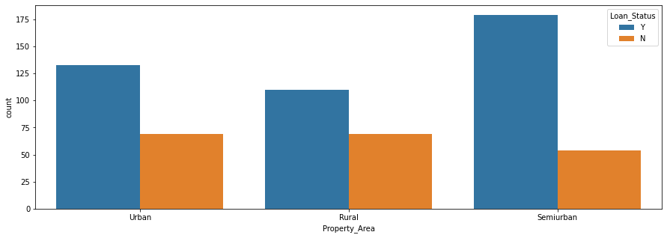
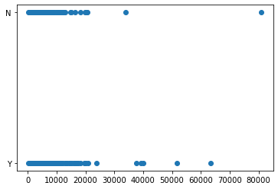
Here it is seen that , in Loan Status= Y
Most of the person who are From SemiUrban Area get loan as well as From Urban And Rural Area.
So regarding the loan Status, SemiUrban Area People has got more than 0.50 chance to get a loan.
For Loan Status = N, it is clear that
it is almost same for the cases, whatever your Property Area maybe.
So it is not a good way to measure the association between Loan Status and Property Area.
Loan Status Association With Property Area
Scatter Plot For Features :
So from the Scatter Plot, it is clear that there is No Relationship between Loan Status With ApplicantIncome.
Loan Status Association With ApplicantIncome

Slide 12
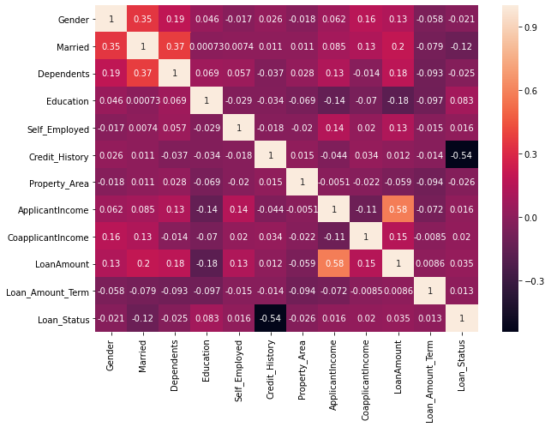
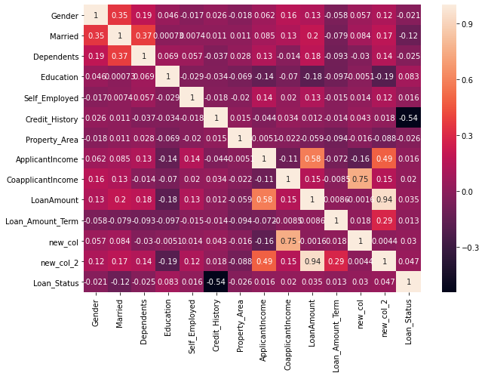
Correlation Plots Between Features-I :
So we can see the relationship between each and every features from Correlation Plot.
We can conclude that Credit History and Married Status are good features, actually Credit History is the best .
Here we got 0.58 similarity between Loan Amount and Applicant Income.
Correlation Plot
Here, I have two new columns defined as:
new col = Coapplicant Income/ Applicant Income.
new col2 = Loan Amount *Loan Amount Term.
Modified Correlation Plot

Slide 13
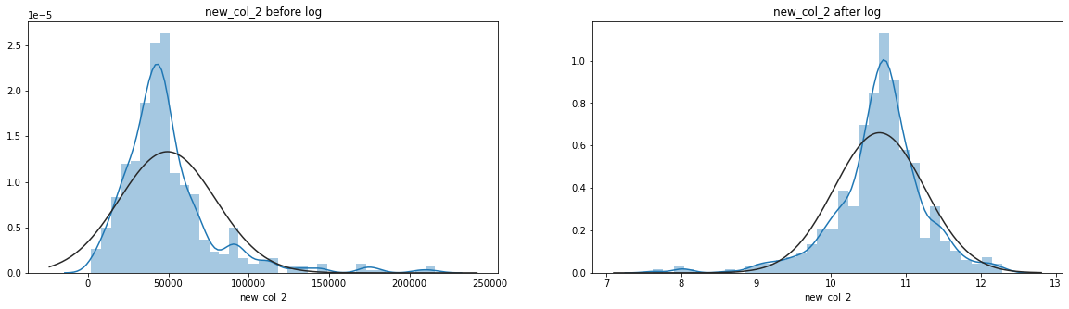
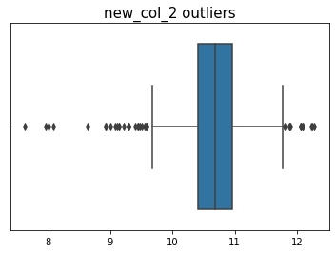
Distribution Graph :
For new col2 we can see we got Right Skewed Distribution.
We can solve this problem with very simple statistical technique, by taking the logarithm of all the values
because the data is Normally Distributed that will help improving our model.
Distribution Plot
Box Plots :
RESULTS:
Quartile 25: 10.416008100285975
Quartile 75: 10.961277846683982
iqr: 0.5452697463980076
Cut O: 0.05452697463980077
Lower: 10.361481125646174
Upper: 11.015804821323783
Numbers of Outliers: 218
Box Plot With Outliers

Slide 14
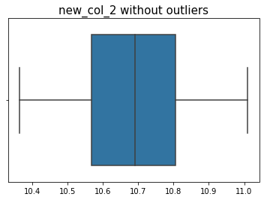
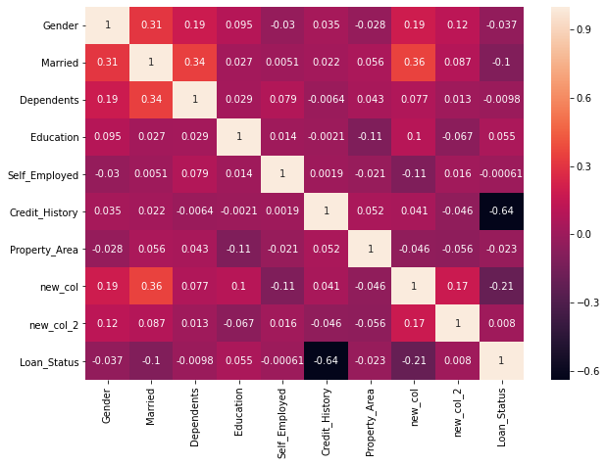
Box Plot Without Outliers
Correlation Plots Between Features -II :
We have seen that Self Employed with Loan Status got really bad corr (-0.00061) ,so we will remove it and see what happen.
Modified Correlation Plot

Slide 15
Modified Correlation Plot
TERMINOLOGIES UESD :
Principal Component Analysis :
An important Machine Learning method for dimensionality reduction is called Principal
ComponentAnalysis(PCA).
It is a method that uses simple matrix operations from Linear Algebra and Statistics to calculate a projection
of the Original data into the same number or Fewer Number.

Slide 16
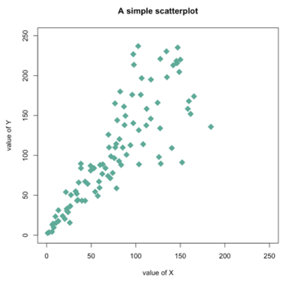
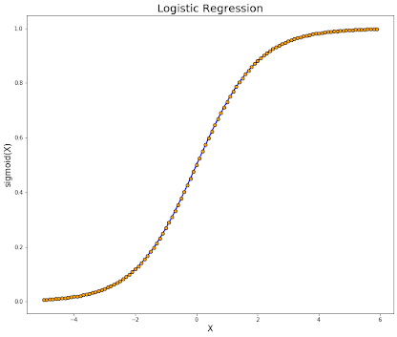
Scatter Diagram :
A Scatter Plot is a type of plot or Mathematical Diagram using Cartesian Coordinates to display values for typically
two variables for a set of dataset.
It Generally lies between +1 to -1. Where the Extreme values shows perfect correlation, Positive Or Negative may
be. Value close to 0 shows Zero Correlation.
Scatter Plot
Logistic Regression :
In Statistics, the Logistic Model is used to model the Probability of a certain class or even existing such
as pass/fail, win/lose, alive/dead or healthy/sick. This can be extended to model several classes of events
such as determining whether an image contains a cat or a dog or classing the classes properly.
Logistic Regression

Slide 17
KNeighbors Classifier :
The K-Nearest Neighbors (KNN) algorithm is a type of supervised machine learning algorithms. KNN
is extremely easy to implement in its most basic form, and yet performs quite complex classification tasks.
KNN works by ending the distances between a query and all the examples in the data , selecting the specified
number examples (K) closest to the query.
Support Vector Classifier :
The objective of a Linear SVC is to fit the data provided , returning the Best Fit hyperplane that divides
or categorizes data.
Decision Tree Classifier :
Decision Tree Learning is one of the predictive modelling approaches used in Statistics, Data Mining
and Machine Learning. It uses a decision tree to go from observations about an item to conclusions about
the item's target value.
Loss Function :
Machine learns by means of a Loss Function. It is a method of evaluating how well specific algorithm
models the given data . If predictions deviates too much from actual results, loss function would cough
up a very large number.
The Lower the Loss Function, the Better the Predicted Model.

Slide 18
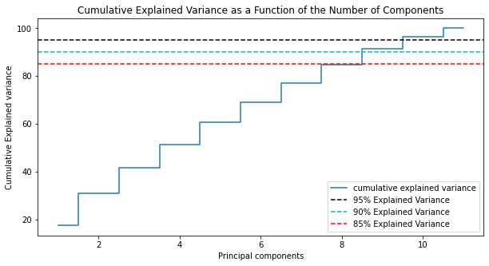
5. PROJECT RESULTS :
Results From PCA :
Filtering the Dataset, I have done the PCA analysis and got the following Result :
If n components is not set, all components are kept (11 in this case).
Total Explained Variance : 11.025700934579454
Cumulative Explained Variance : array([ 17.3988806 , 30.80902058, 41.63884139, 51.26280458, 60.51732821,
69.14419256, 77.04206011, 84.58157718, 91.27831426, 96.47690067, 100. ])
Components Required To Explain Variance : (cum var exp 0.99) = 11, (cum var exp 0.95) = 10,
(cum var exp 0.90) = 9, (cum var exp 0.85) =9
PCA ANALYSIS

Slide 19
Results From Model Analysis :
At the very beginning performing different models on dataset, the result that we got is depicted below :
Decision Tree Classifier :
pre: 0.929
rec: 0.422
f1: 0.580
loss: 6.612
acc: 0.809
Logistic Regression :
pre: 0.930
rec: 0.429
f1: 0.587
loss: 6.542
acc: 0.811
SVC :
pre: 1.000
rec: 0.013
f1: 0.026
loss: 10.692
acc: 0.690
Kneighbors Classifier :
pre: 0.667
rec: 0.364
f1: 0.471
loss: 8.863
acc: 0.743
We can see that best model is Logistic Regression at least for now, SVC is just memorizing the data so it is overfitting.
After some modification we got the result below :
Logistic Regression :
pre 0.894048
rec 0.422500
f1 0.562733
loss 6.752695
acc 0.804490
Kneighbors Classifier :
pre 0.379834
rec 0.207500
f1 0.259954
loss 12.381887
acc 0.641510
SVC :
pre 0.000000
rec 0.000000
f1 0.000000
loss 11.043955
acc 0.680245
Decision Tree Classifier :
pre 0.919048
rec 0.422500
f1 0.565740
loss 6.611717
acc 0.808571
As it can be seen SVC is just memorizing the data, and one can see that here Decision Tree Classifier is better than Logistic Regression or Both are good here.

Slide 20
Now we look at the value counts of every label :
For Gender :
1 398
0 93
For Married :
1 315
0 176
For Dependents :
0 292
2 85
1 78
3 36
For Education :
0 382
1 109
For Self Employed :
0 428
1 63
For Credit History :
1 421
0 70
For Property Area :
1 179
2 170
0 142
For new col :
0.000000 222
0.414374 1
0.912892 1
1.258120 1
0.504299 1
...
0.330420 1
2.332134 1
0.844471 1
0.564642 1
0.824769 1
For new col2 :
43200.0 18
39600.0 13
36000.0 11
57600.0 11
46080.0 9
..
3000.0 1
12000.0 1
9072.0 1
25920.0 1
7560.0 1

Slide 21
6. CONCLUSION :
In this project, we explore different aspects of incorporating neural, statistical and external features to deep neural networks on the task of loan prediction. We also presented in-depth analysis of several state-of-the-art recurrent and convolution architectures. The presented idea leverages features extracted
using different models.
From the used models, it is seen that Logistic Regression performs the best and Decision Tree Classifier also performs the same level as the Previous one. But Among all SVC performs the worst, it generally overestimates the data and gives very bad result.
Though there is still scope for further improvement in the topic and hope to be explored in future.

